Slide 1
Flight Price Prediction
Luddy School of Informatics
INDIANA UNIVERSITY BLOOMINGTON

Slide 2
Overview
Goal of the Project
Plan of Approach.
Results.
Work in Progress.

Slide 3
Flight fare Prediction
Improving R2 score and decreasing the RMSE for the best model
Goal of the Project
Goal of the Project

Slide 4
Exploratory Data Analysis
Correlation
Modelling
Data Cleaning
Plan of Approach
Goal of the Project
Evaluation

Slide 5
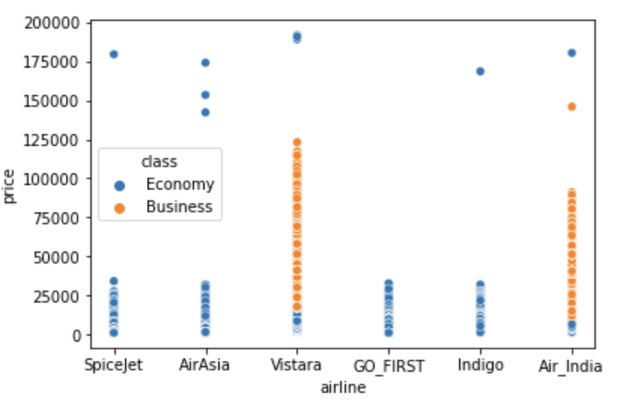
Exploratory Data Analysis
Identifying if columns have null/missing values
Identifying outliers
Data Visualization

Slide 6
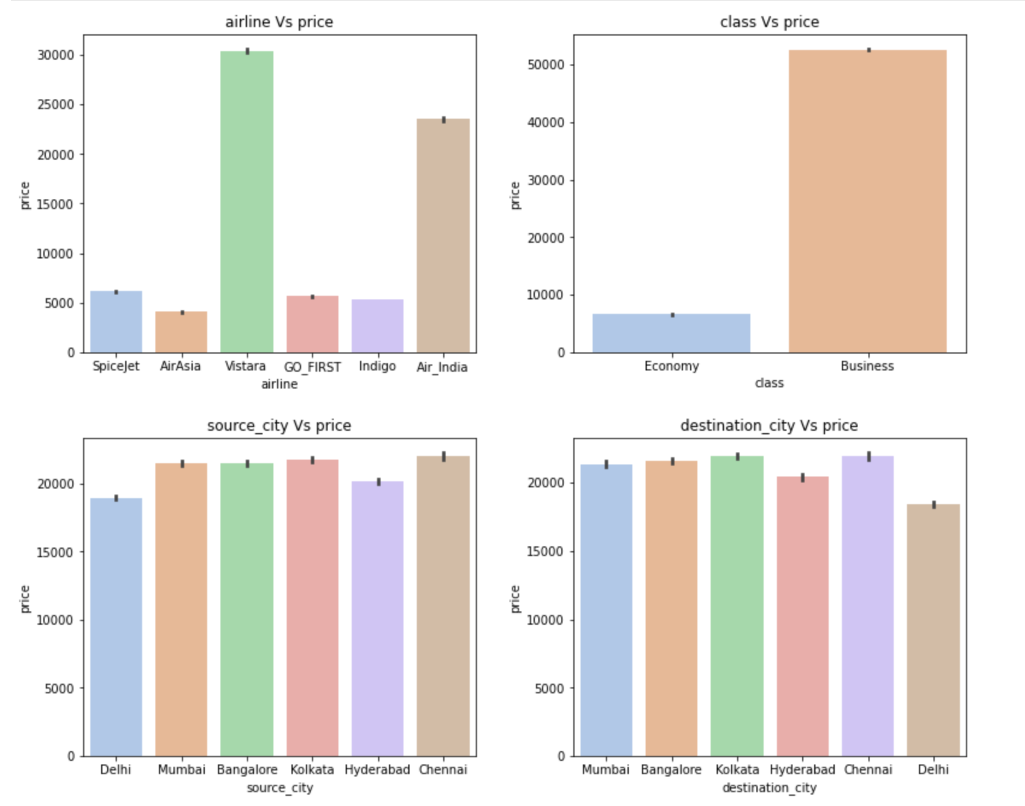

Slide 7
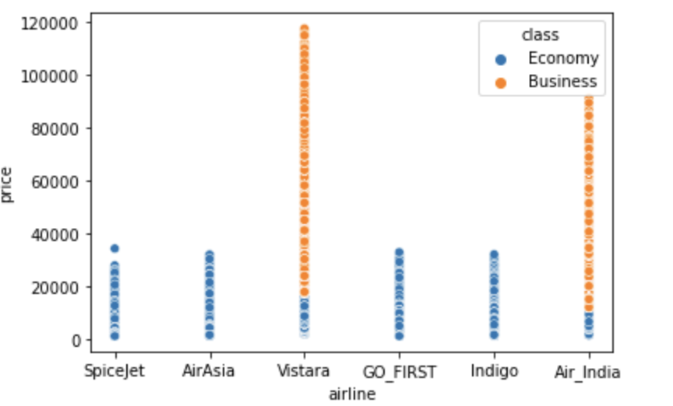
Data Cleaning
Dropping redundant columns.
Dropping outliers using IQR technique
Implementing python code to convert “stops” attribute to numerical value
Using label encoding technique to convert categorical data to numerical values

Slide 8
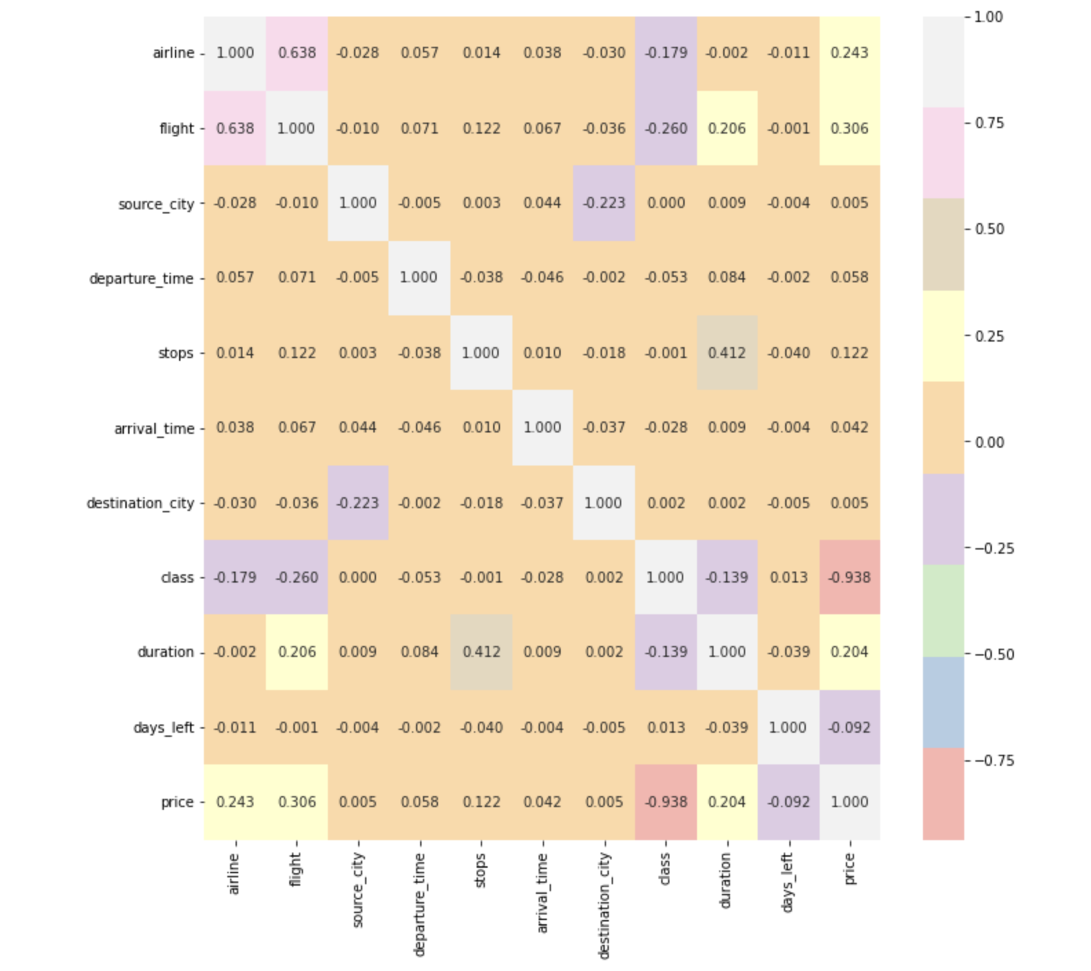
Correlation
Plotted a correlation matrix between the attributes
From the matrix, it is observed that price is negatively correlated with class.

Slide 9
Modeling
Implemented three regression models.
Linear Regression
Bagging Regression
Random Forest Regression
Used 67.7% data for training the models and rest for testing purpose.

Slide 10
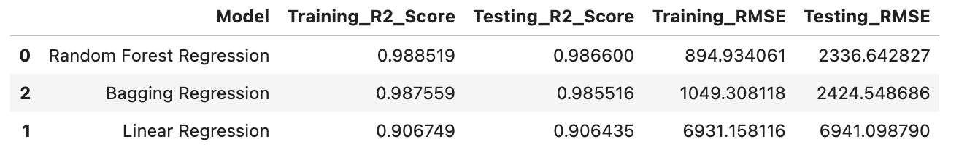
Evaluation
The performance metric used are R Squared Score (R2 Score), Root Mean Square Error (RMSE) to evaluate the performance of the regression models.

Slide 11
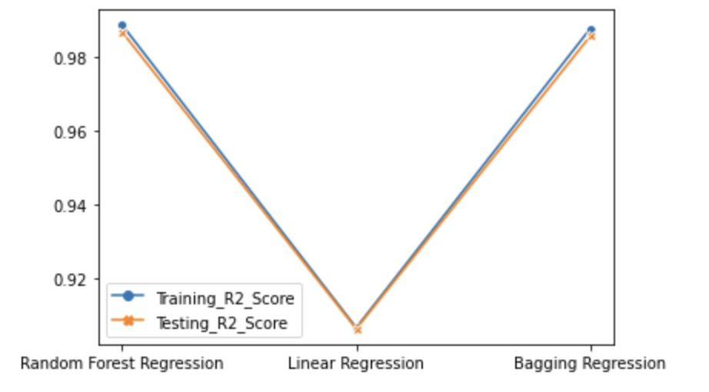
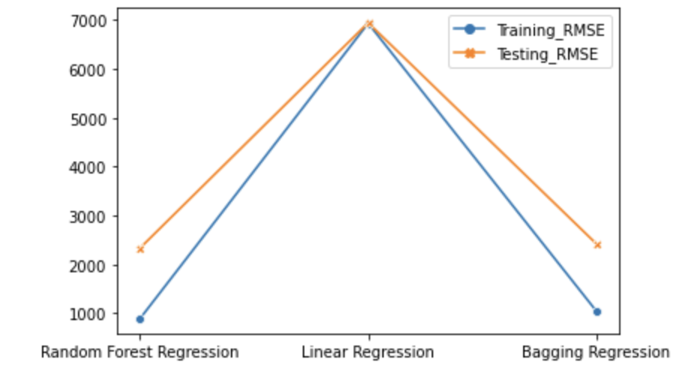
R2 Score
RMSE

Slide 12
Results

Slide 13
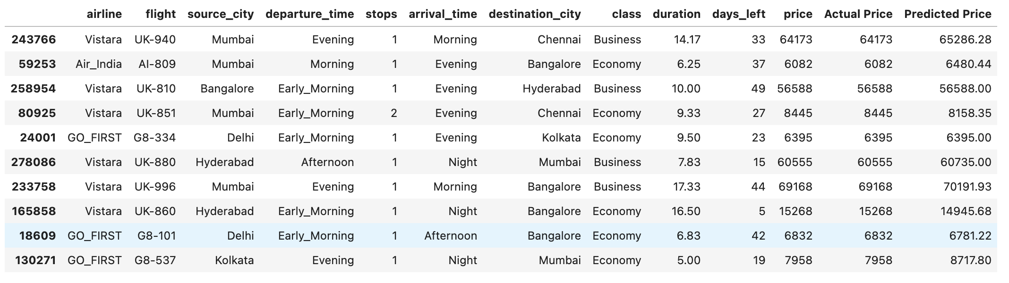
Price Prediction

Slide 14
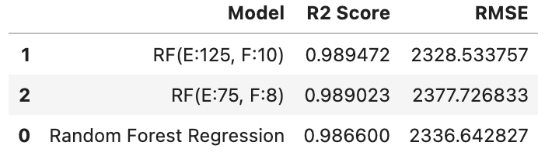
Hyperparameter Tuning
To improve the R2 Score of the Random Forest Regression model further, its most important hyperparameters are tuned.

Slide 15
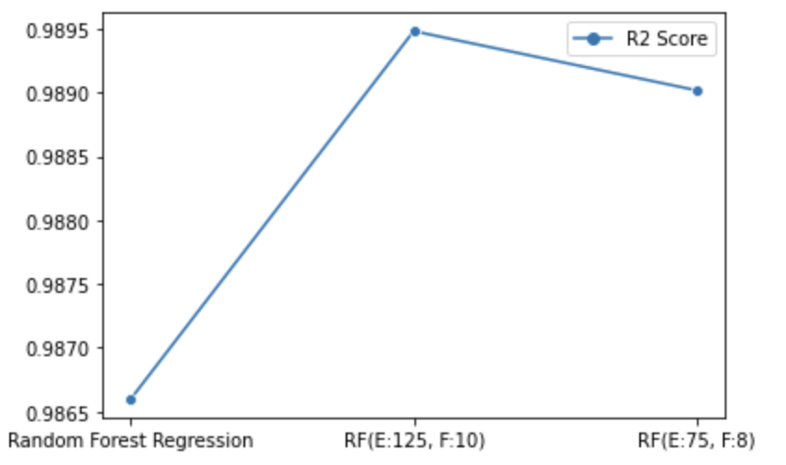
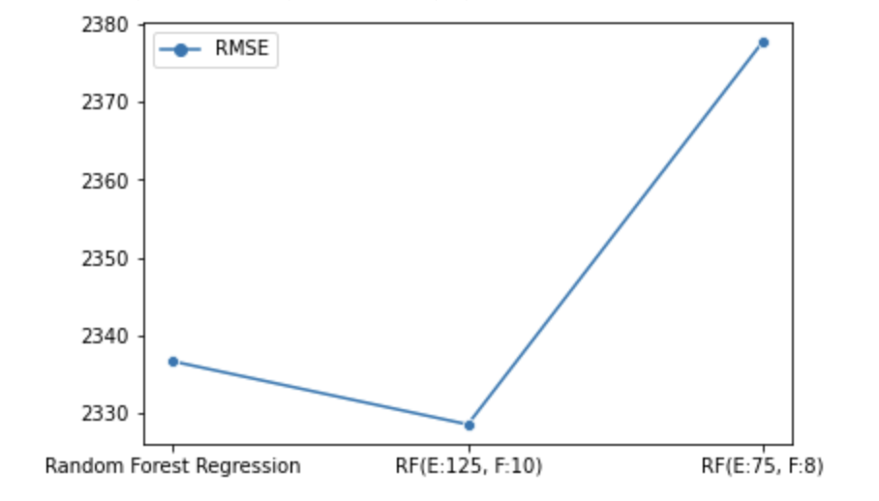
R2 Score
RMSE

Slide 16
Hyperparameter Tuning using GridSearchCV or RandomSearchCV to -
Improve R2 Score
Decrease RMSE
Work in Progress

